Slide 1
Student Rating of Instructor Survey

Slide 2
WHAT
Student Rating of Instructor Surveys
Surveys are confidential – I don’t see your survey and I don’t know if you complete the survey or not
I receive a report of summarized survey data
I don’t receive the report until after grades have been submitted

Slide 3
WHY
I value your input
I use your input to improve the class.
Student ratings are used to make decisions regarding faculty tenure and promotion

Slide 4
Students should strive to avoid cultural and social biases when assessing faculty effectiveness on the SRIS form, focusing instead on the effectiveness of instruction.

Slide 5
Such biases may include but are not limited to race, ethnicity, sexual orientation, gender identity or expression, national origin, religion, language, disability, and health related characteristics of your instructor.
Students should also strive to avoid bias against their instructor due to course materials challenging their beliefs.
Faculty have similarly committed themselves to avoiding cultural and social biases when evaluating student work and when there is disagreement with challenging course materials.

Slide 6
HOW
You will receive an email from
SRIS@wcupa.edu
with a link to your surveys

Slide 7
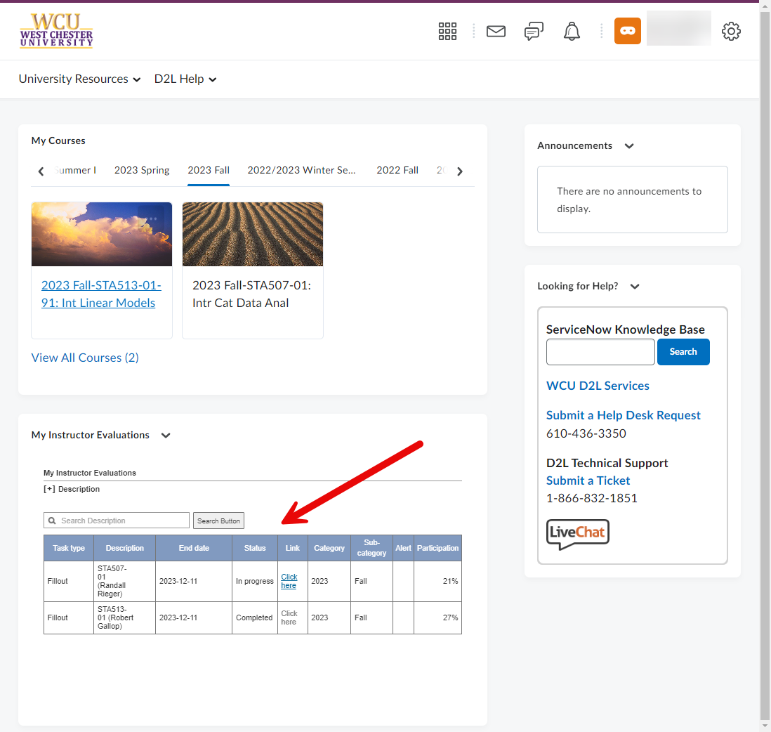
HOW
You can also access
your surveys from
the D2L home page.

Slide 8
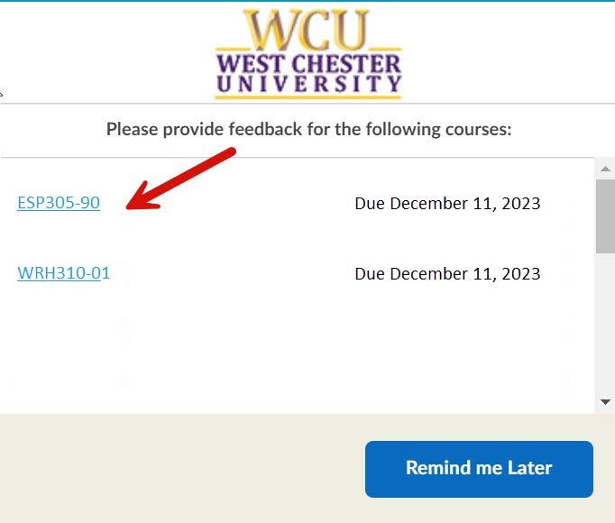
HOW
You may also receive pop-up reminders in D2L with links to your surveys.

Slide 9
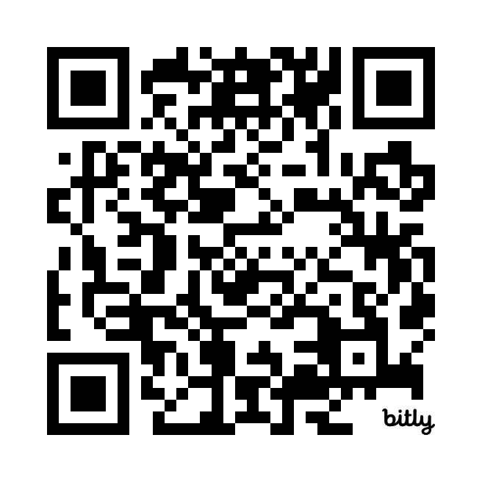
Please complete the survey now
https://SRIS.wcupa.edu
Thank you for your participation!

