Slide 3
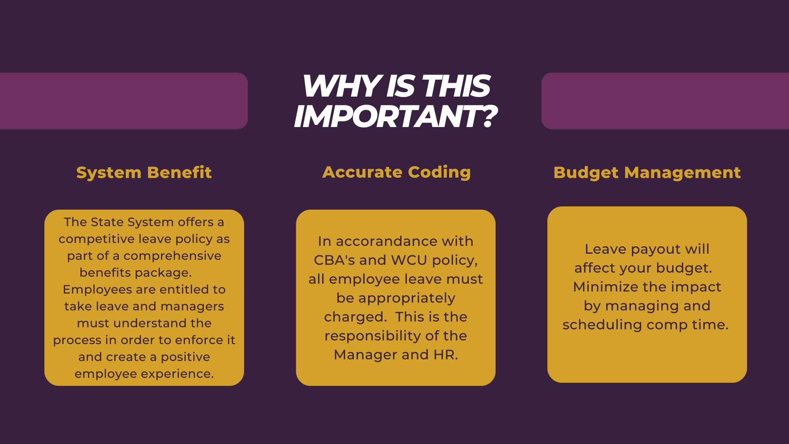

Slide 6
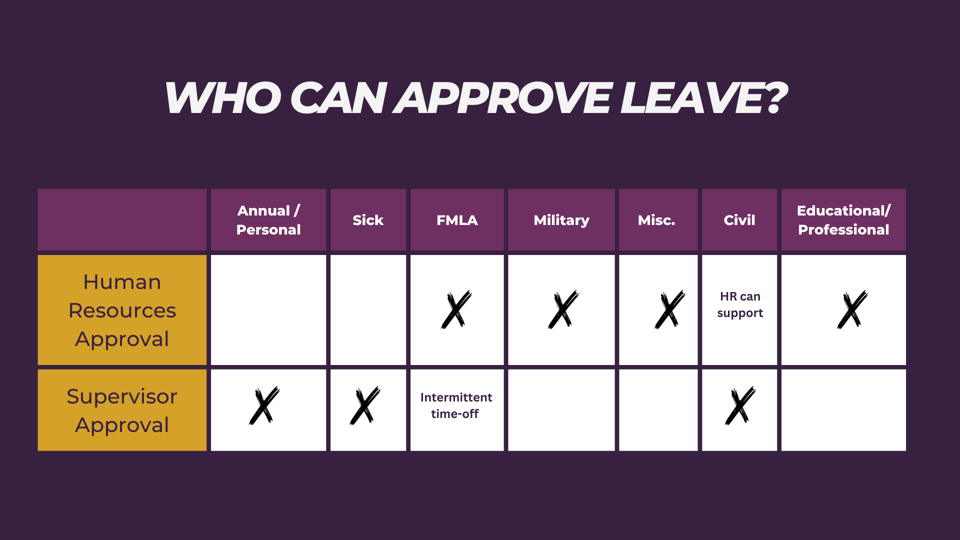

Slide 11
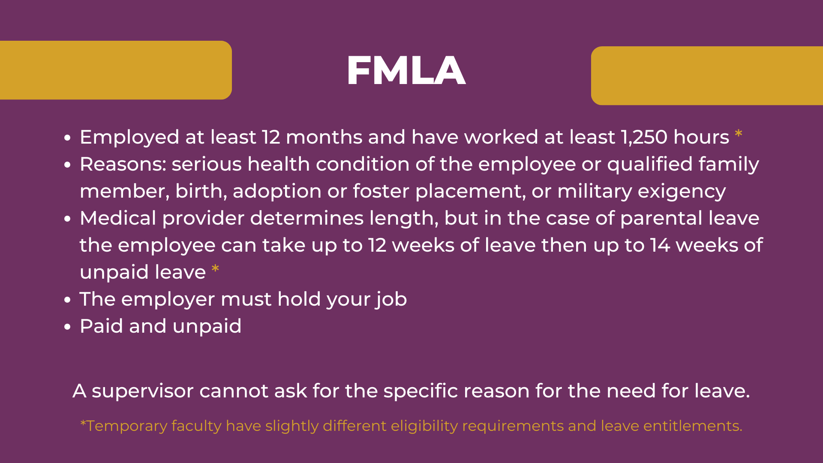

Slide 12
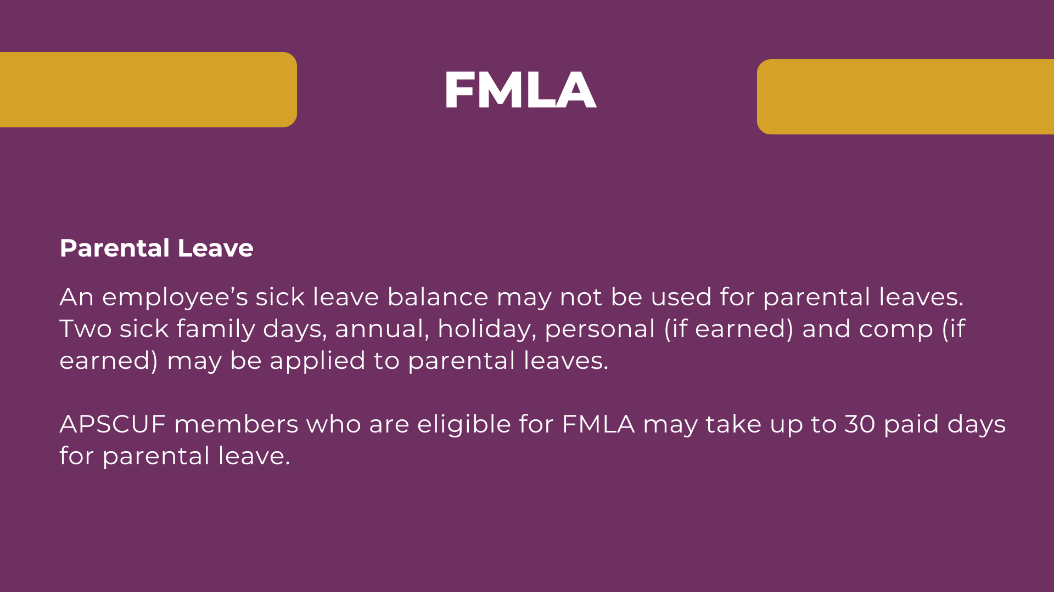

Slide 17
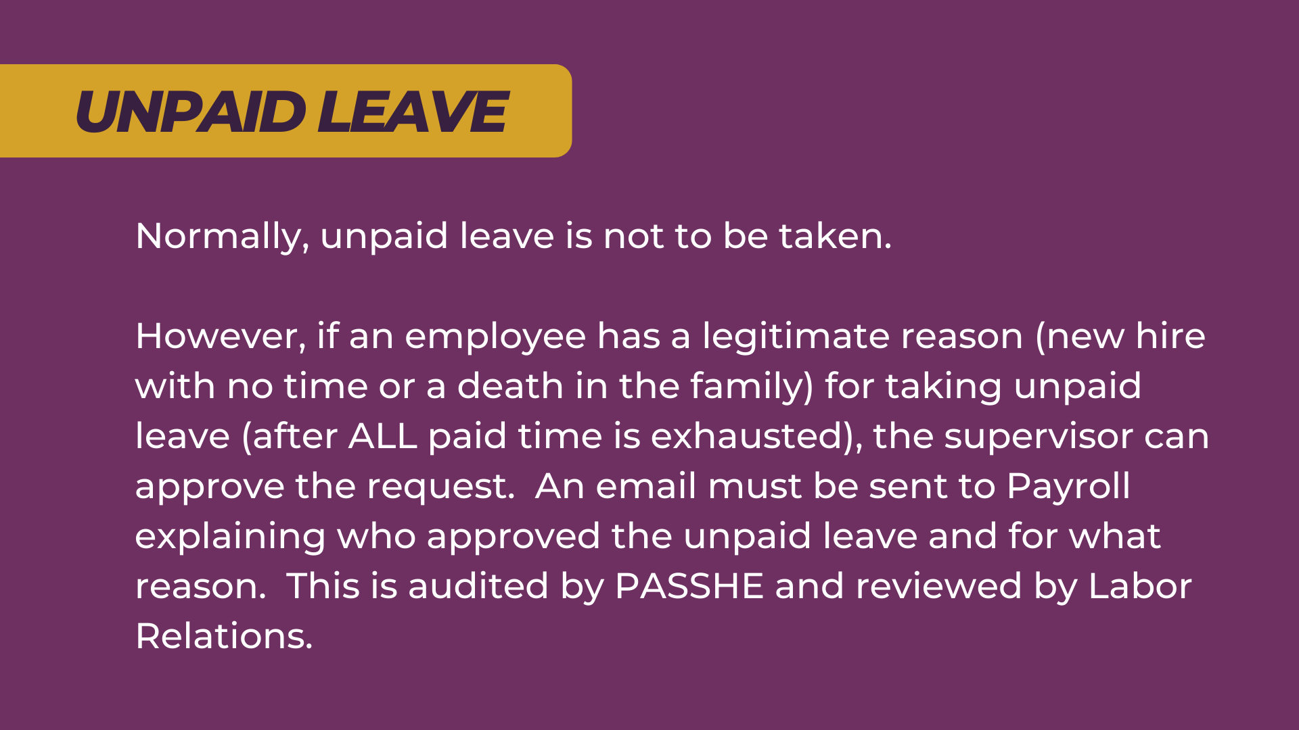

Slide 21
RESOURCES
Human Resources Contact
Leave Manager- Sue Robb x3117
Collective Bargaining Agreements
CLICK for 2025 Holiday Schedule
General Leave Accrual and Time Off

